Slide 1
APUSH Review: Plessy v. Ferguson (1896)
Everything You Need To Know About Plessy v. Ferguson To Succeed In APUSH

Slide 2
Key Ideas Before The Case
Reconstruction Amendments:
13th Amendment
Abolished slavery
14th Amendment
Granted citizenship, equal protection
15th Amendment
Suffrage for African American males
Jim Crow Laws
Segregation laws in the South

Slide 3
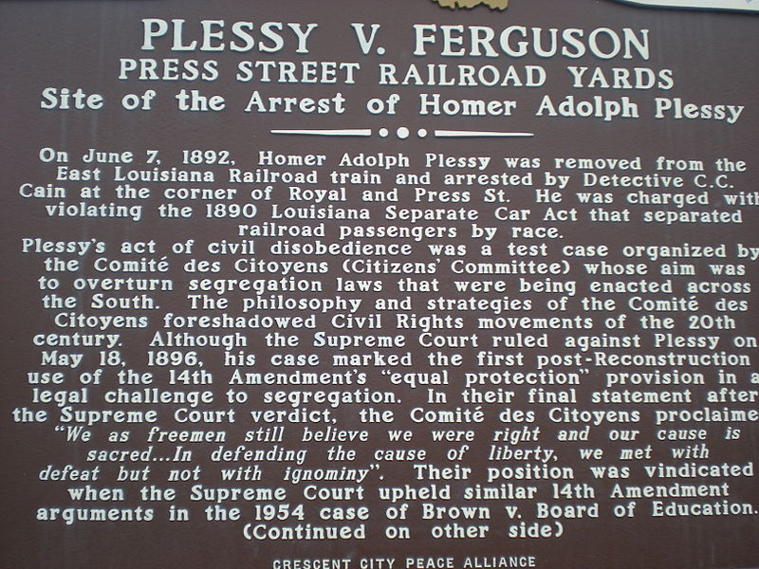
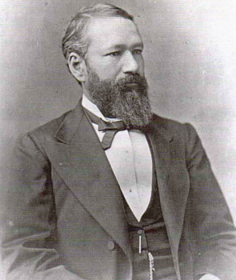
Homer Plessy
Citizens’ Committee
Civil Rights group
Wanted to challenge segregation laws in Louisiana
Separate Car Act
Required “equal, but separate” train cars for blacks and whites
Homer Plessy:
Biracial, lived in Louisiana
Arrested for sitting in the first-class section of a white train car

Slide 4
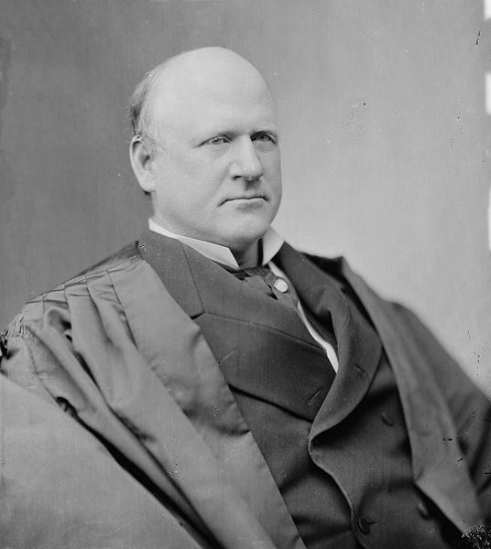
The Supreme Court Decision
In view of the constitution, in the eye of the law, there is in this country no superior, dominant, ruling class of citizens. There is no caste here. Our constitution is color-blind, and neither knows nor tolerates classes among citizens. In respect of civil rights, all citizens are equal before the law.
Plessy sued citing the 14th amendment, “no state shall make or enforce any law which shall abridge the privileges or immunities of citizens of the United States….”
Louisiana Judge ruled that the state could regulate railroads within the state
The Supreme Court decision:
Sided against Plessy and for Louisiana in a 7 – 1 decision
Lone dissenter was Justice John Marshall Harlan

Slide 5
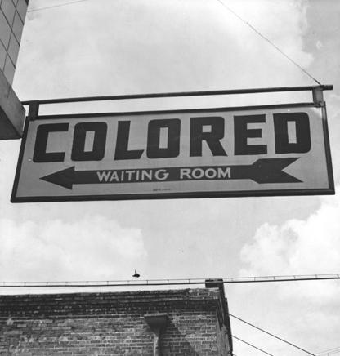
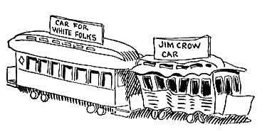
Effects of the Court Case
Jim Crow laws are upheld by the Supreme Court
“Separate but equal” remains in effect for 58 years
In reality, separate facilities were NOT equal
Plessy v. Ferguson was finally overturned in 1954, and 1964:
1954: Brown v. Board of Education
1964: Civil Rights Act of 1964
John McCutcheon – cartoon from 1904

Slide 6
Thanks for watching!
Subscribe to my channel
Help spread the word
Questions? Comments? Ideas for videos?
Leave in comments
Subscribe
Down here!

